Slide 1
Standard JAXB 2.0 Java/XML Binding
Service-Oriented Software Engineering
Software Institute
Nanjing University
Bei Jia

Slide 2
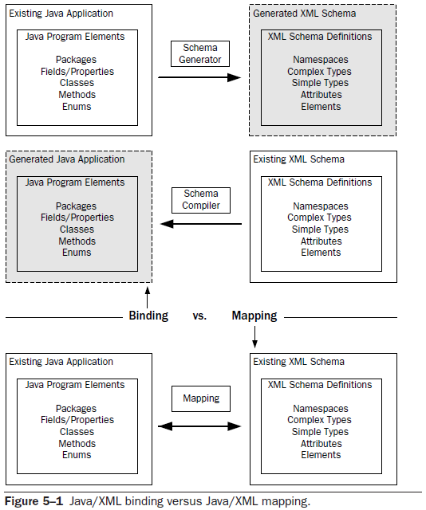
Binding versus Mapping (1/3)

Slide 3
Binding versus Mapping (2/3)
A binding tool converts Java types to XML types according to a standard mapping.
  It implements a standard way of converting Java to XML (and vice versa)
In this manner, a binding tool typically enables you to implement type mappings in two ways:
  Start from an existing Java application and use a schema generator to create a machine-generated XML schema
  Start from an existing XML schema and use a schema compiler to create a machine-generated Java application
When working with a Java/XML mapping tool, you need to define the mappings between the XML and the Java. At runtime, the mapping tool uses your mapping definitions to serialize Java to XML or deserialize XML to Java

Slide 4
Binding versus Mapping (3/3)
JAXB 2.0 is primarily a binding tool
The annotations allow customization of the standard JAXB binding, which provide a mapping from the Java code to the schema. But…
  They flexibility is limited by annotations. there are lots of mappings that cannot be supported without resorting to custom coding using the XmlAdapter class
  The mapping defined by annotations is static. You can’t implement a different mapping without changing the annotations and recompiling the Java
So, when working with JAXB 2.0, you are limited to the standard JAXB 2.0 Java/XML mapping and the customizations that can be expressed using the JAXB 2.0 annotations (with the schema generator) or the JAXB 2.0 binding language (with the schema compiler)

Slide 5
The Schema simpleorder.xsd (1/2)
<?xml version="1.0" encoding="UTF-8"?>
<schema targetNamespace="http://www.example.com/oms"
elementFormDefault="qualified" xmlns="http://www.w3.org/2001/XMLSchema"
xmlns:oms="http://www.example.com/oms">
<element name="simpleOrder">
<complexType>
<sequence>
<element name="billTo">
<complexType>
<sequence>
<element name="name" type="string"/>
<element name="street" type="string"/>
<element name="city" type="string"/>
<element name="state" type="string"/>
<element name="zip" type="string"/>
<element name="phone" type="string"/>
</sequence>
</complexType>
</element>
……

Slide 6
The Schema simpleorder.xsd (2/2)
……
<element name="items">
<complexType>
<sequence>
<element name="item" type="oms:ItemType" maxOccurs="unbounded"/>
</sequence>
</complexType>
</element>
</sequence>
</complexType>
</element>
<complexType name="ItemType">
<sequence>
<element name="quantity" type="positiveInteger"/>
<element name="price" type="double"/>
</sequence>
<attribute name="productName" use="required" type="string"/>
</complexType>
</schema>

Slide 7
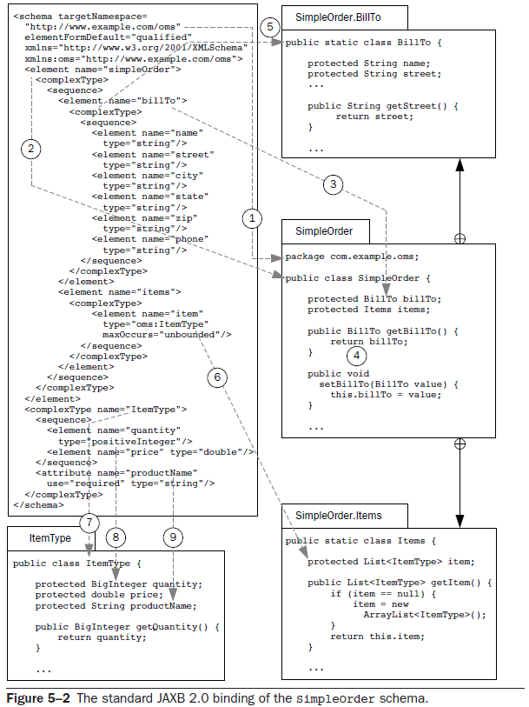
An Overview of the Standard JAXB 2.0 Java/XML Binding
Can be customized by the jaxb:package declaration or the @XmlSchema.namespace annotation element
In the default mapping, anonymous complex types get mapped to top-level classes only when they are defined by global element definitions
The standard binding for anonymous complex types (that are not defined by global elements) is to make them inner classes. You can force all classes to be generated as top-level by using the <jaxb:globalBindings localScoping="toplevel"/> global declaration
When the element definition has a maxOccurs value greater than 1, the standard binding maps element to List<T> property. The Java type parameter for List<T> is equal to the Java type that is bound to the element definition’s type attribute (or anonymous type). The collection type (the default is java.util.List) can be customized using the binding language collectionType attribute at either the global or the property level
By default, local element declarations are bound to properties
The access method for the property is, by default, Java-Beans style setter/getter methods. There are no declaration in JAXB binding language to bind an element to Java field. But we can use @XmlElement annotation to do the reverse
The default mapping for xs:positiveInteger (and xs:integer as well) is to java.math.BigInteger. This mapping can be customized using the binding language jaxb:javaType declaration or the @XmlElement.type annotation
The default mapping for attribute declarations, like element declarations, is to properties with JavaBeans style setter/getter methods
The standard mapping for named complexType definitions is to a top-level Java value class

Slide 8
Java Value Class SimpleOrder.java
The annotations are the key to run-time marshalling and unmarshalling
Annotations are also how JAXB 2.0 achieves portability across implementations
Tells the JAXB 2.0 runtime what parts (i.e., fields, properties, or both) of the Java class get mapped by default
Tells the JAXB 2.0 runtime which schema type to map a class to and specifies some aspects of the mapping
@XmlAccessorType(AccessType.FIELD)
@XmlType(name = "", propOrder = {
"billTo",
"items"
})
@XmlRootElement(name = "simpleOrder")
public class SimpleOrder {
@XmlElement(namespace = "http://www.example.com/oms")
protected BillTo billTo;
@XmlElement(namespace = "http://www.example.com/oms")
protected Items items;
Tells the JAXB 2.0 runtime that this class maps to a global element definition
Tells the JAXB 2.0 runtime that a particular property or field maps to a schema element definition

Slide 9
Java Value Class SimpleOrder.BillTo
@XmlAccessorType(AccessType.FIELD)
@XmlType(name = "", propOrder = {
"name"
"street",
"city",
"state",
"zip",
"phone"
})
public static class BillTo {
@XmlElement(namespace = "http://www.example.com/oms", required = true)
protected String name;
@XmlElement(namespace = "http://www.example.com/oms")
protected String street;
@XmlElement(namespace = "http://www.example.com/oms")
protected String city;
@XmlElement(namespace = "http://www.example.com/oms")
protected String state;
@XmlElement(namespace = "http://www.example.com/oms")
protected String zip;
@XmlElement(namespace = "http://www.example.com/oms")
protected String phone;

Slide 10
Java Value Class SimpleOrder.Items
@XmlAccessorType(AccessType.FIELD)
@XmlType(name = "", propOrder = {
"item"
})
public static class Items {
@XmlElement(namespace = "http://www.example.com/oms")
protected List<ItemType> item;
public List<ItemType> getItem() {
if (item == null) {
item = new ArrayList<ItemType>();
}
return this.item;
}
}
This accessor method returns a reference to the live list, not a snapshot. Therefore any modification you make to the returned list will be present inside the JAXB object. This is why there is not a set method for the item property
For example, to add a new item, getItem().add(newItem);

Slide 11
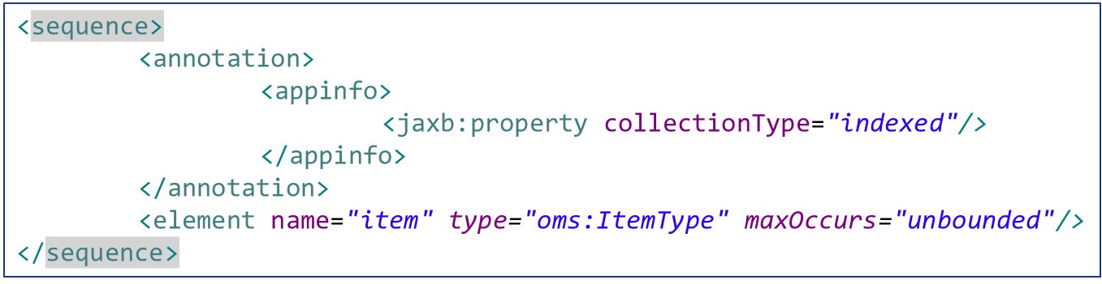
Specify an alternative collection type
With a <property> declaration, we can Specify an alternative collection type
We will map the item element to an array property (i.e., ItemType[]), rather than a list. With a setter method:

Slide 12
Java Value Class ItemType.java
xs:positiveInteger is mapped to a property with class java.math.BigInteger
By default, Marshalling process does not validate its output against the source schema
@XmlAccessorType(AccessType.FIELD)
@XmlType(name = "ItemType", propOrder = {
"quantity",
"price"
})
public class ItemType {
@XmlElement(namespace = "http://www.example.com/oms")
protected BigInteger quantity;
@XmlElement(namespace = "http://www.example.com/oms", type = Double.class)
protected double price;
@XmlAttribute(required = true)
protected String productName;
is used to map property to an attribute

